Slide 1

CSE 229:Engineering ethics and cyber law
Presented by:
Dr. Mst. Jannatul Ferdous
Professor
Department of Computer Science and Engineering
Jatiya Kabi Kazi Nazrul Islam University, Bangladesh
Email: mjferdous_cse@jkkniu.edu.bd, mjannatul@gmail.com
3rd September, 2023

Slide 2
What is Ethics?
Derived from the Greek word “ethos”, which means “way of living”, ethics is a branch of philosophy that is concerned with human conduct, more specifically the behavior of individuals in society.
Ethics examines the rational justification for our moral judgments;
It studies what is morally right or wrong, just or unjust.

Slide 3
Senses of Ethics
Moral principles that govern a person’s behavior or the conducting of an activity.
The branch of knowledge that deals with moral principles.
Ethics is an activity of
Understanding the moral values
Resolve the moral issues
Justify the moral judgment
Ethics refers to a set of beliefs, attitudes, and habits that a person or group displays concerning morality.
Ethics is a purely factual matter about explaining beliefs and actions related to morality.
Ethics refers to being “morally correct”
People’s actions can be spoken of as “ethical” or “unethical”
Individuals can be evaluated as “ethical” or “unethical”

Slide 4
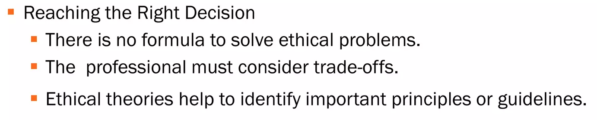
Ethical views

Slide 6
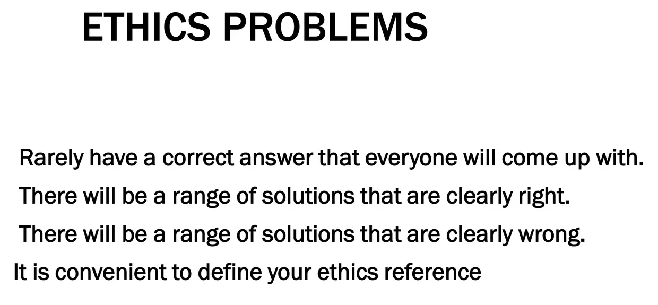

Slide 7
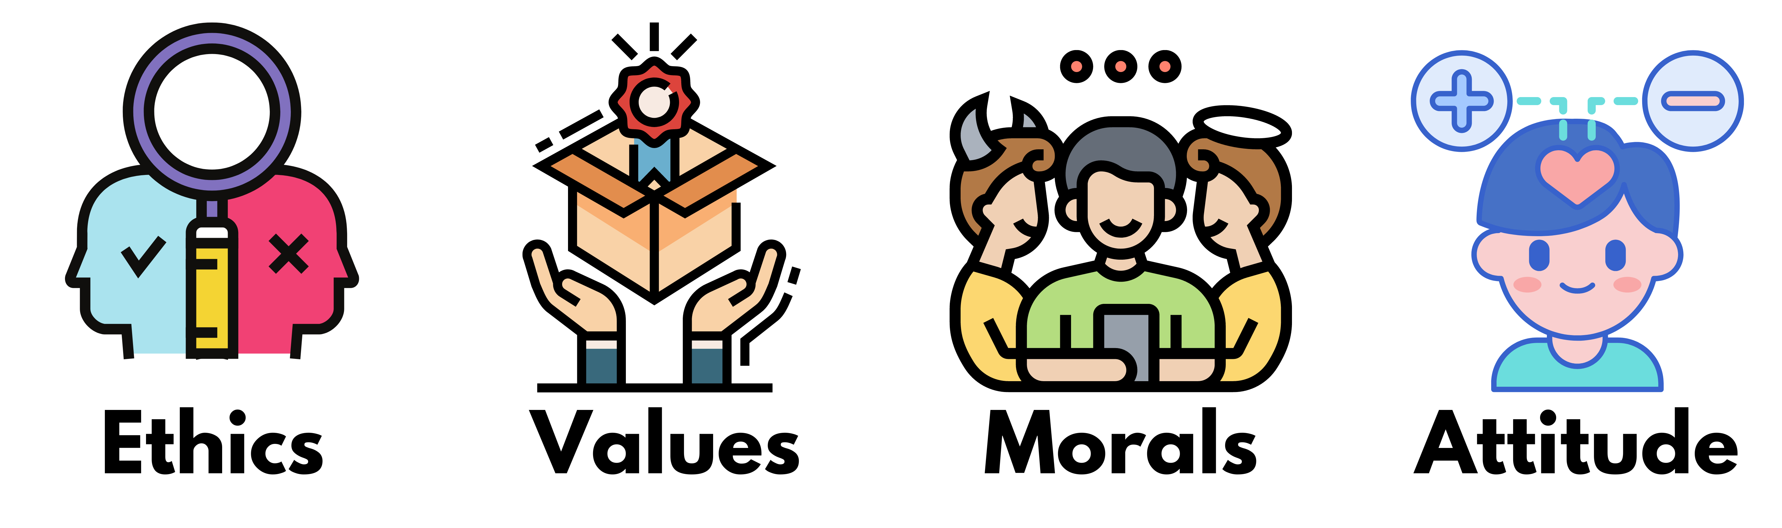
Attitudes, values, ethics, and morals are mental constructs that guide our behavior. They are responsible for influencing our choices, guiding our decision-making, and directing our behavior.

Slide 8
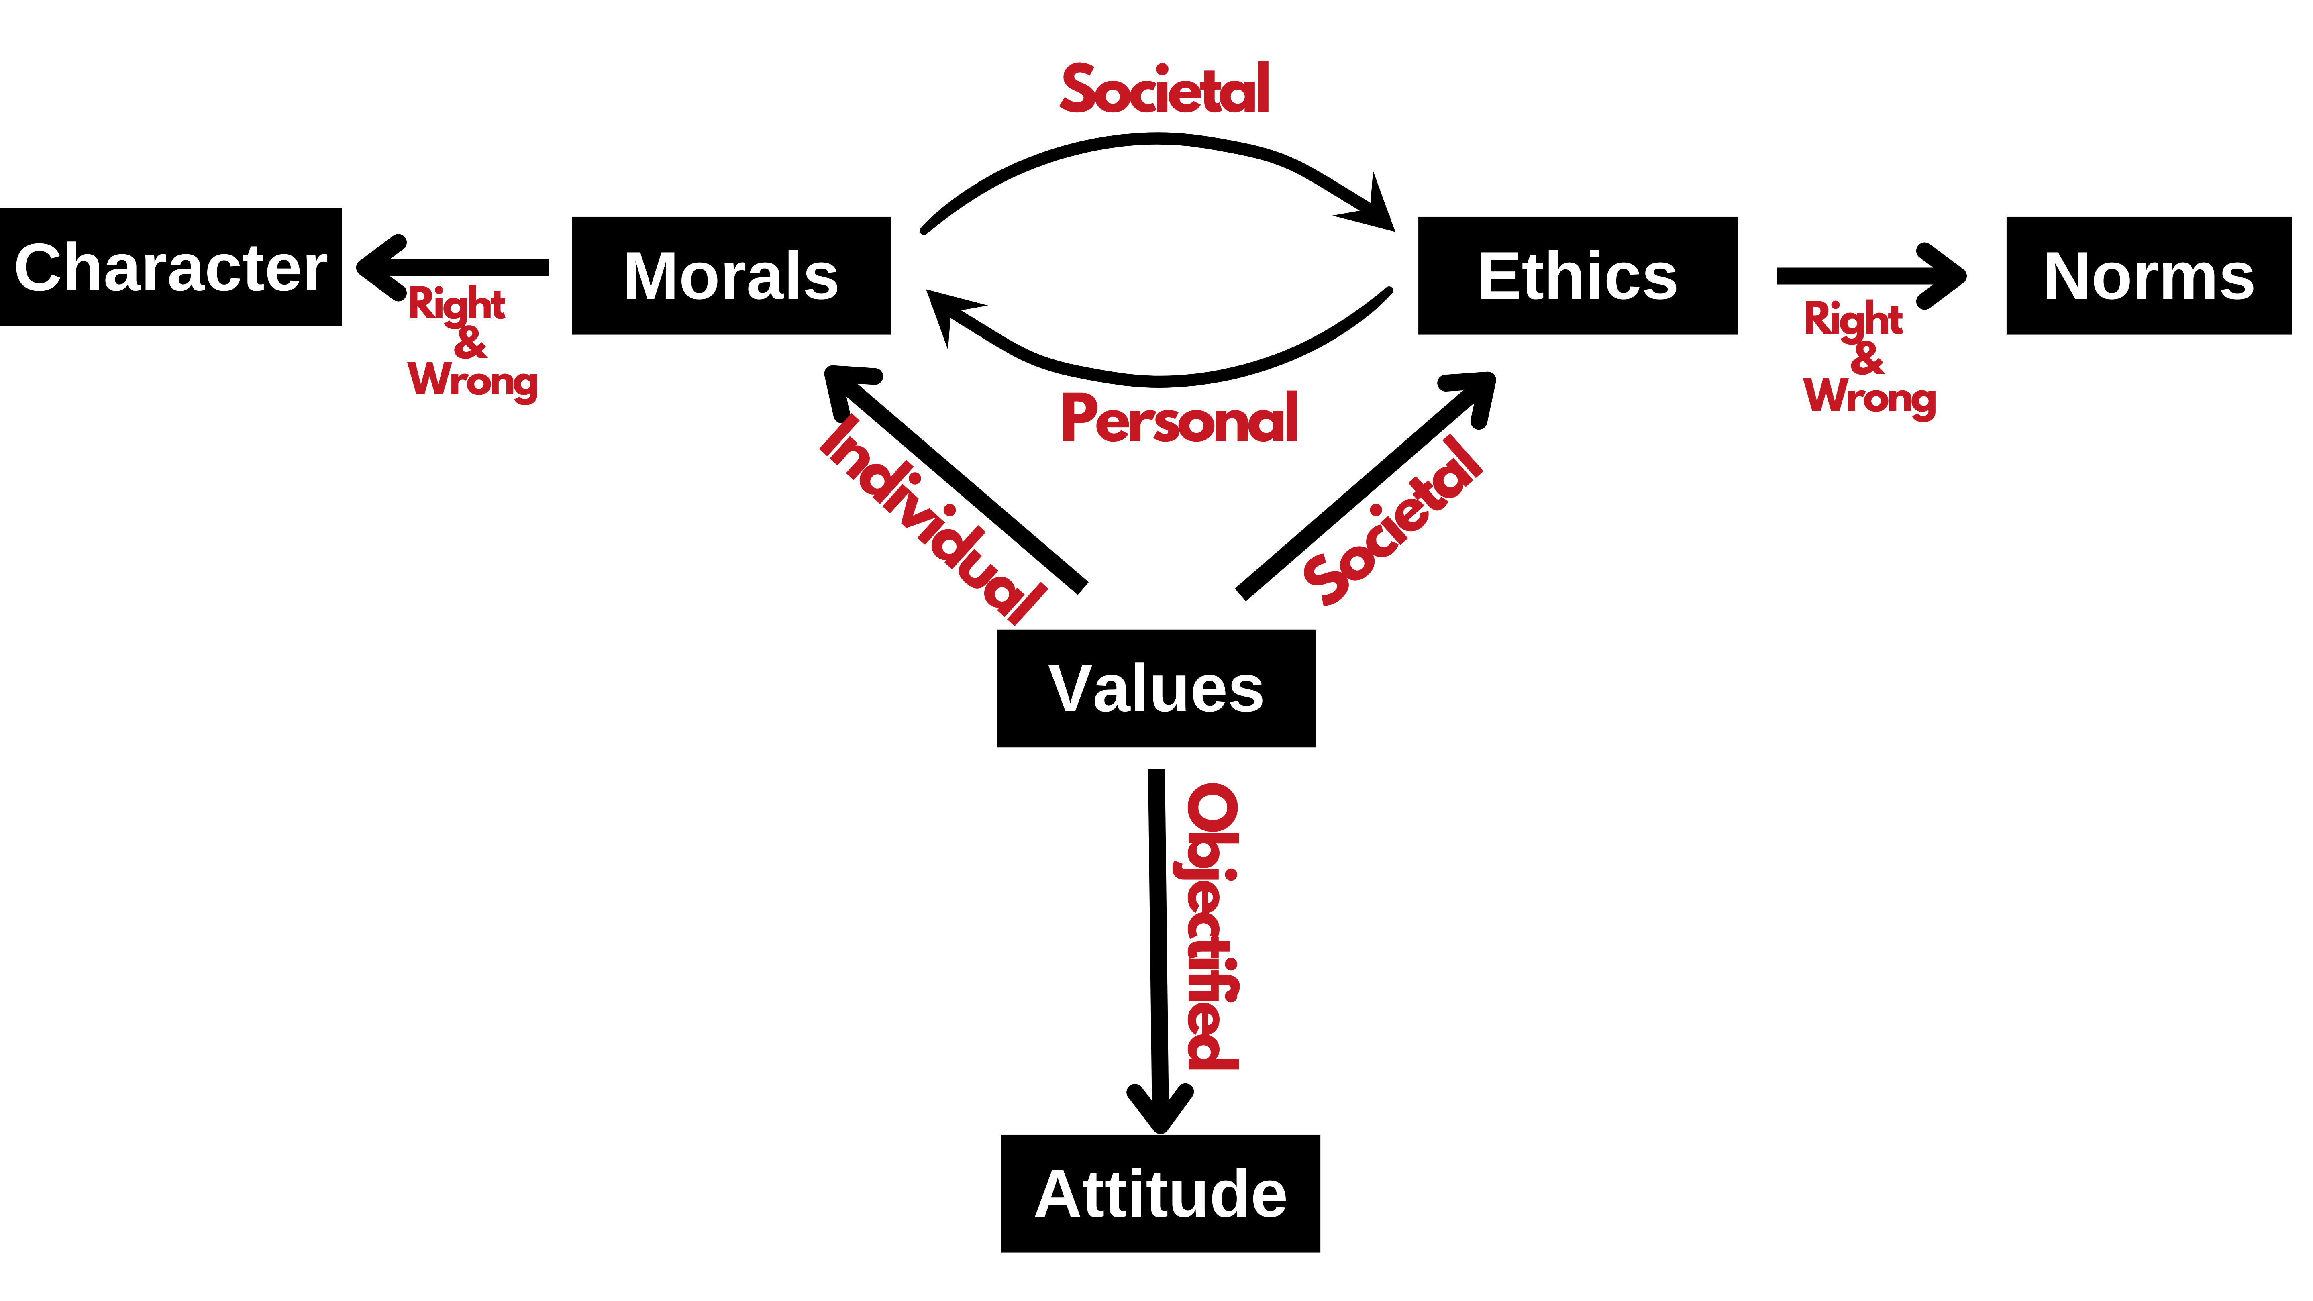
How is EVMA interrelated?

Slide 9
According to Charles Colson, “Morality describes what is, whereas Ethics describes what ought to be”. Fundamentally, morals refer to a set of rules defining what is considered to be right or wrong and accepted without questions. These rules are typically defined by society. If someone breaks such a rule then he is typically considered to have been “bad” or “immoral.”
Values, on the other hand, provide direction in the determination of right versus wrong or good versus bad. Values are what an individual believes to have worth and importance or to be valuable. As such, morals are values defining right from wrong or good from bad.

Slide 10
Differentiate between morals and ethics
Ethics vs. Morals
Ethics and morals relate to “right” and “wrong” conduct. While they are sometimes used interchangeably, they are different: ethics refer to rules provided by an external source, e.g., codes of conduct in workplaces or principles in religions. Morals refer to an individual’s principles regarding right and wrong.

Slide 11
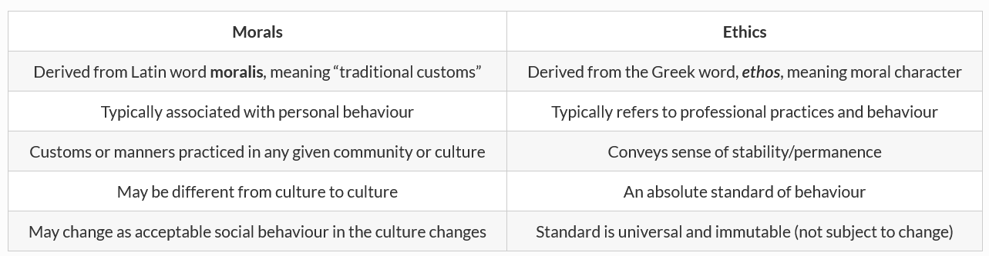
Values influence individuals' thoughts, feelings, and actions - guiding their behavior throughout life. Our values act as a compass to help us make decisions, especially when faced with difficult choices. Values can be intrinsic (meaning they come from within) or extrinsic (from external factors).
Values can be categorized as:
Intrinsic Values: These are values that are internal to an individual. They are values that the individual believes in for their own sake.
Extrinsic Values: These are values that come from external factors. They are values that an individual believes in because they think it will help them achieve something else that they value.
*Traditional customs, beliefs, or methods are ones that have existed for a long time without changing.
*Sake: the purpose for doing something

Slide 12
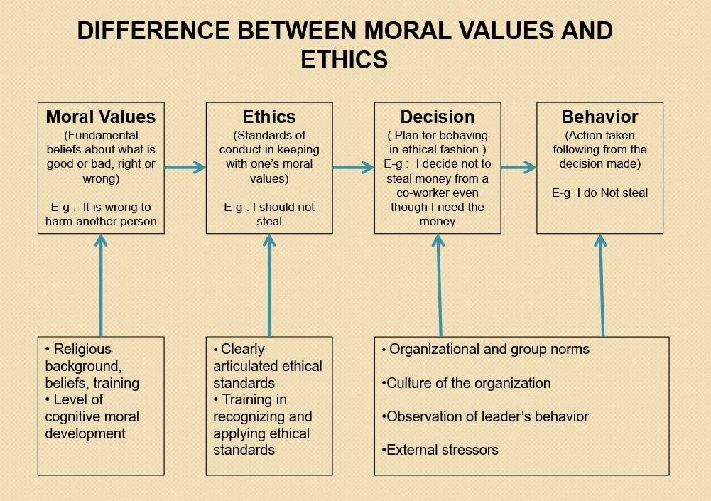
Cognition: the mental action or process of acquiring knowledge and understanding through thought, experience, and the senses.

Slide 13
5 moral values for every working professional
Honesty
Discipline
Professionalism
Respecting colleagues and their spaces
Accepting others

Slide 14
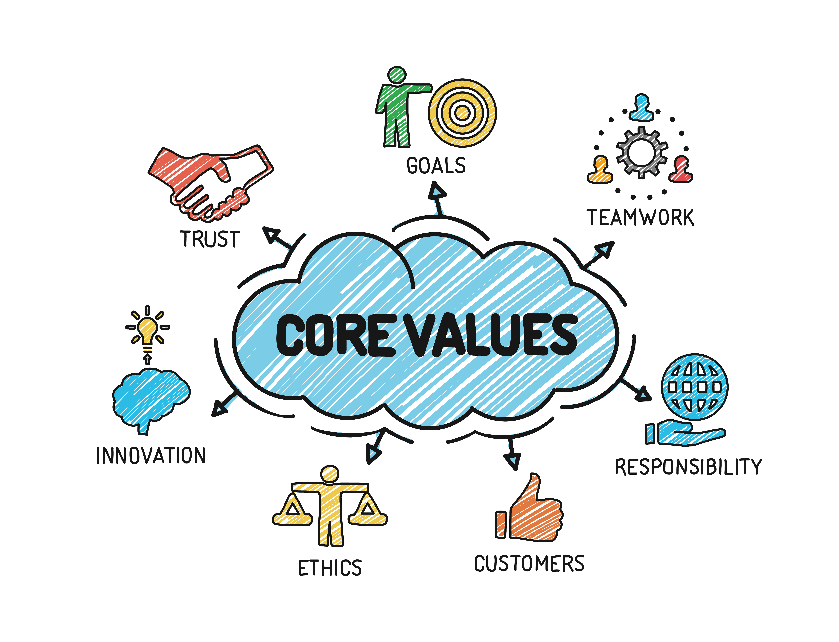
Ethics and Human Interface: Essence, determinants and consequences of Ethics in human actions; dimensions of ethics; ethics — in private and public relationships.

Slide 15
Integrity
# The quality of being honest and having strong moral principles.
What are the 5 attributes of integrity?
Dependability. Dependability means people can rely on you and that you keep promises. ...
Loyalty. Employers especially value and appreciate the loyalty of their employees. ...
Honesty. Integrity requires honesty. ...
Good judgment. ...
Respect.

Slide 16
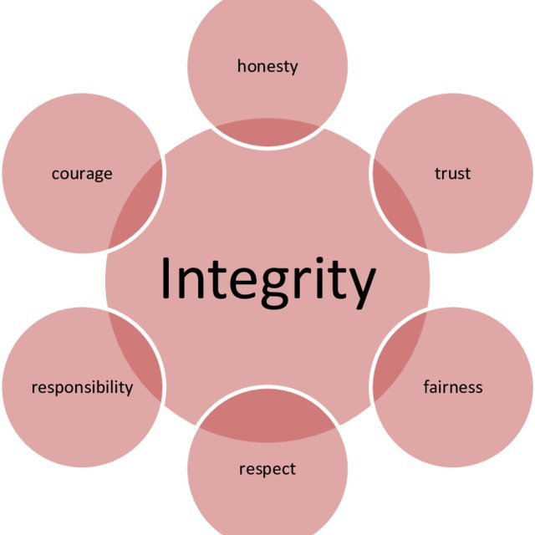
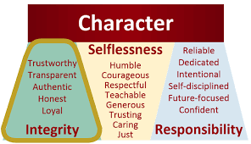

Slide 17
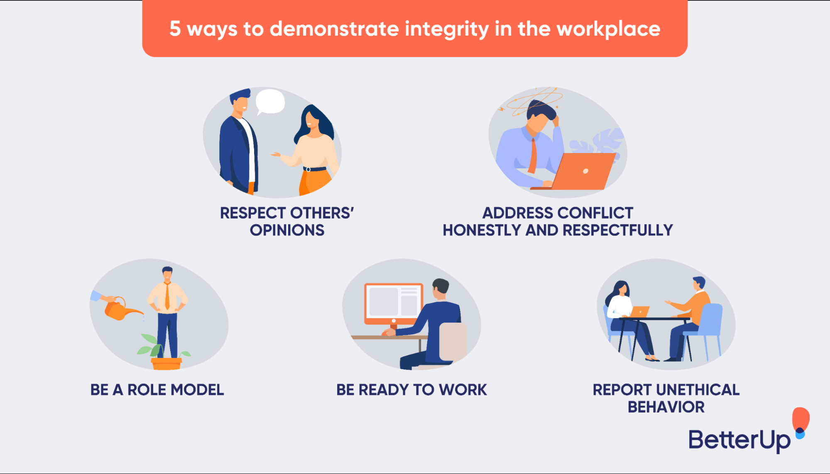
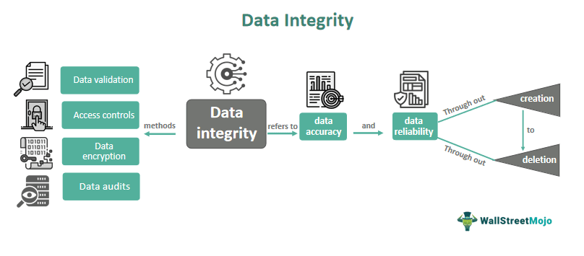

Slide 18
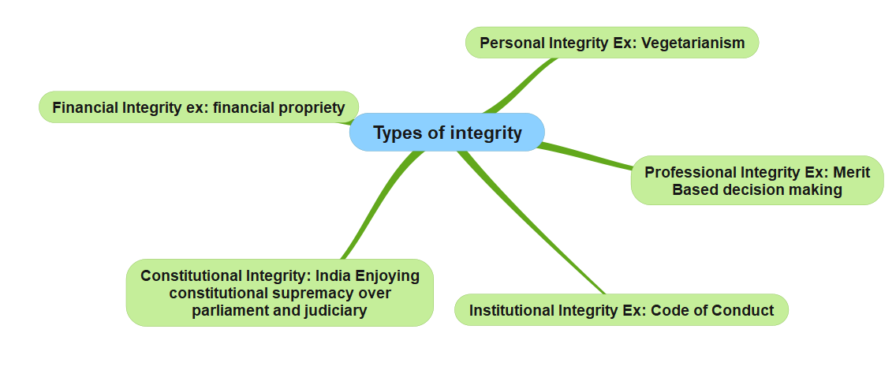

Slide 19
Types of integrity in ethics
Integrity is thus considered as one of the most important virtues and has many interpretations as:
Integrity as self-integration. ...
Integrity as identity. ...
Integrity is standing for something. ...
Integrity as purpose. ...
Personal integrity. ...
Professional integrity. ...
Institutional integrity.

Slide 20
What is work ethic?
The concept of work ethic involves a set of principles, values, and beliefs that influence how individuals behave and make decisions in their professional lives. It directly affects productivity, job satisfaction, and the overall reputation of a company.
According to a recent survey conducted by ZipDo, an astonishing 83% of employees view work ethic as a highly important trait in their coworkers. This data highlights the significance of work ethic in today’s work environment.
*https://zipdo.co/
ZipDo | Meeting Operating System
ZipDo is a meeting management and productivity software that enables teams to reduce the time they spend in meetings by following a repeatable process that ...

Slide 21
The 5 pillars of work ethics
1. Integrity
This involves being honest, ethical, and reliable in all professional dealings. It’s about doing the right thing, even when no one is watching.
How to achieve it: Be honest and ethical in all your dealings. Keep your promises and be reliable.
2. Responsibility
This involves taking ownership of one’s actions and decisions and being accountable for the outcomes.
How to achieve it: Take ownership of your actions and decisions. Be accountable for the outcomes.
3. Quality
This involves striving for excellence and taking pride in one’s work.
How to achieve it: Strive for excellence in your work. Take pride in what you do.

Slide 22
4. Discipline
This involves showing commitment, perseverance, and self-control in achieving one’s goals.
How to achieve it: Show commitment and perseverance in achieving your goals. Exercise self-control.
5. Teamwork
This involves working effectively with others to achieve common goals.
How to achieve it: Work effectively with others. Be cooperative and supportive.

Slide 23
Service-learning
Service Learning is an educational approach where a student learns theories in the classroom and at the same time volunteers with an agency (usually a non-profit or social service group) and engages in reflection activities to deepen their understanding of what is being taught.
It is a cycle of theories, practices, and reflection tools to broaden knowledge and critical thinking skills for social change.
https://www.elmhurst.edu/blog/what-is-service-learning/

Slide 24
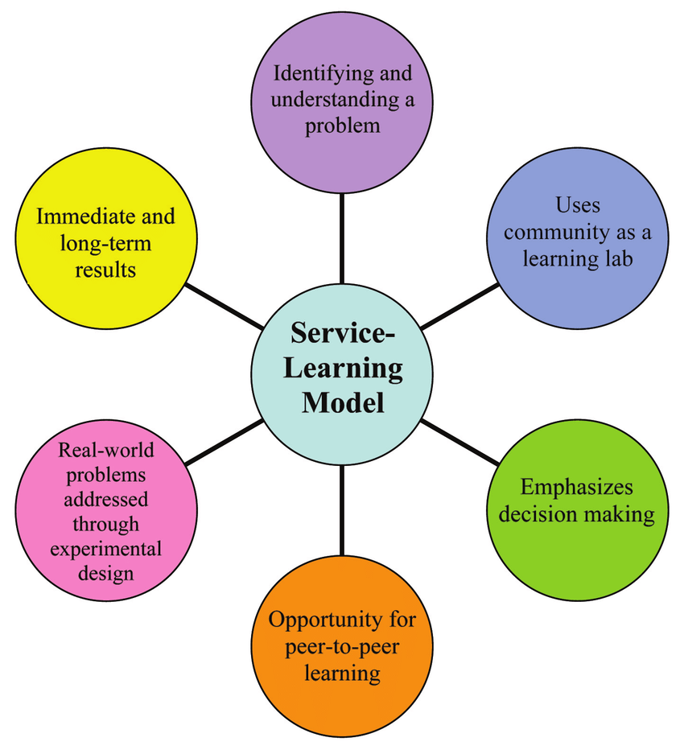
Benefits of a service-learning Integrated Planning Model (IPM) model
Service-learning is an experiential learning pedagogy that moves students beyond the classroom to become active participants in their learning and develop civic knowledge and skills. Students who take service-learning courses work with local, national, and international non-profit and public organizations to deeply learn and practice course content by working on a real, community-identified need. Students learn the course material, get to work directly on an issue facing the community, and learn about their communities in the process.

Slide 25
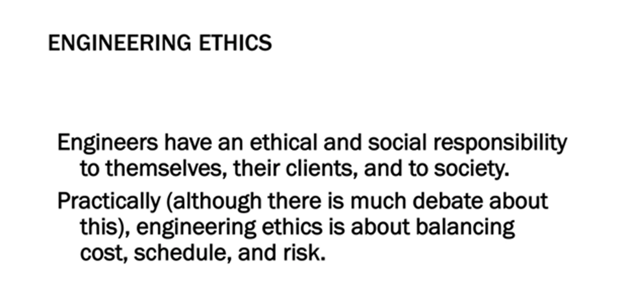
Engineering Ethics
Engineering Ethics is an activity of
Understanding the moral values that ought to guide the engineering profession
Resolve the moral issues in the profession
Justify the moral judgment concerning the profession.

Slide 26
Civic virtue
Civic virtue is morality or a standard of righteous behavior in relationship to a citizen's involvement in society. An individual may exhibit civic virtue by voting, volunteering, organizing a book group, or attending a parent-teacher association (PTA) meeting.

Slide 27
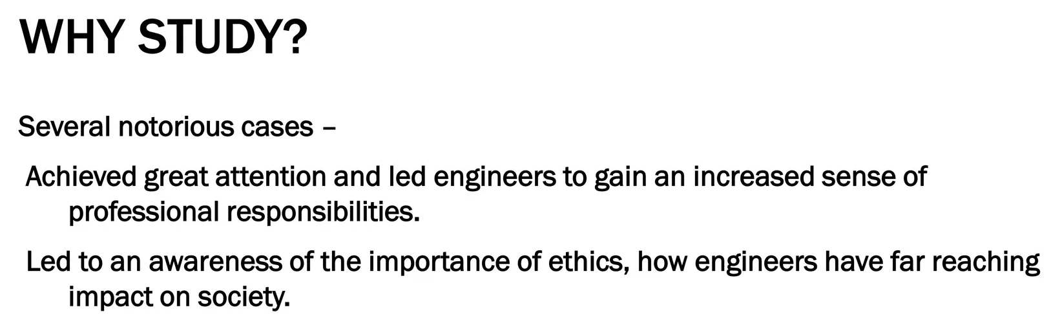

Slide 28
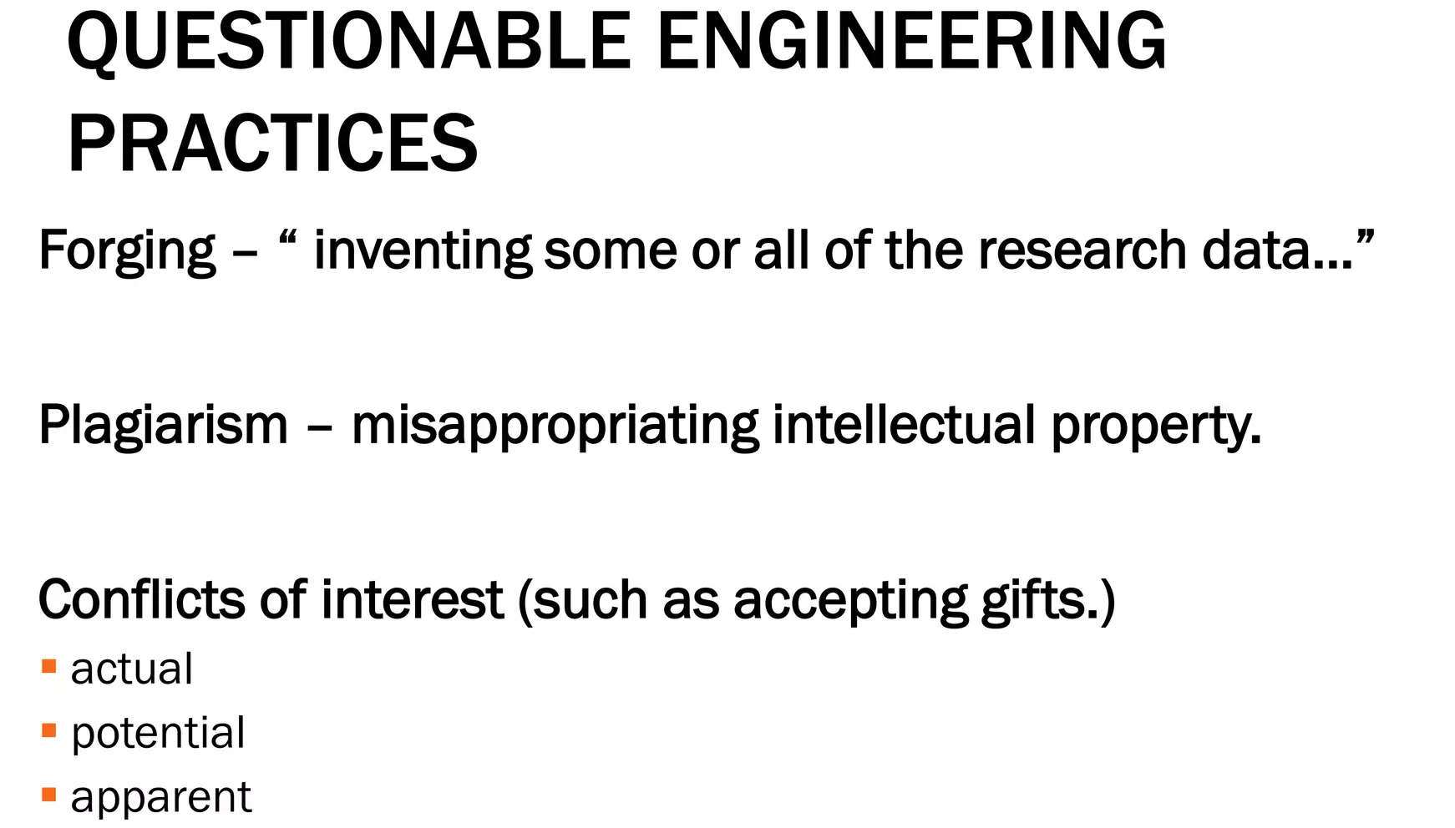

Slide 29
What Is a Code of Ethics?
A code of ethics is a guide of principles designed to help professionals conduct business honestly and with integrity. A code of ethics document may outline the mission and values of the business or organization, how professionals are supposed to approach problems, the ethical principles based on the organization's core values, and the standards to which the professional is held.
A code of ethics, also referred to as an "ethical code," may encompass areas such as business ethics, a code of professional practice, and an employee code of conduct.

Slide 30
What Is a Code of Ethics for Teachers?
A code of ethics for teachers defines the primary responsibilities of a teacher to their students and the role of the teacher in the student's life. Teachers are required to show impartiality, integrity, and ethical behavior in the classroom.
What Is an Example of a Code of Ethics?
An example of a code of ethics would be a business that drafts a code outlining all the ways the business should act with honesty and integrity in its day-to-day operations, from how its employees behave and interact with clients, to the types of individuals it does business with, including suppliers and advertising agencies.
What Is the Difference Between a Code of Ethics and a Code of Conduct?
A code of ethics is broader in its nature, outlining what is acceptable for the company in terms of integrity and how it operates.6 A code of conduct is more focused in nature and instructs how a business' employees should act daily and in specific situations.

Slide 31
Professional Engineering
National Institute for Engineering Ethics (NIEE)
https://www.niee.org/
Codes of Ethics
Accreditation Board For Engineering And Technology
American Institute Of Chemical Engineers
American Society Of Civil Engineers
American Society Of Mechanical Engineers
IEEE Code of Ethics
National Council of Examiners for Engineering and Surveying (NCEES) Model Rules of Professional Conduct
National Society of Professional Engineers (abbreviated as NSPE), NSPE Code of Ethics for Engineers
Software Engineering Code Of Ethics And Professional Practice

Slide 32
NIEE Code of Ethics-1
Engineers shall hold paramount the health, safety, and welfare of the public in the practice of their profession.
Engineers shall practice only in their areas of competence, in a careful and diligent manner and in conformance with standards, laws, codes, and rules and regulations applicable to engineering practice.

Slide 33
NIEE Code of Ethics - 2
Engineers shall examine the societal and environmental impact of their actions and projects, including the wise use and conservation of resources and energy, in order to make informed recommendations and decisions.
Engineers shall issue public statements only in an objective and truthful manner. If representing a particular interest, the engineer shall clearly identify that interest.

Slide 34
NIEE Code of Ethics - 3
Engineers shall sign and take responsibility for all engineering work that they prepare or directly supervise.
Engineers shall act as faithful agents for their employers or clients and maintain confidentiality they shall avoid conflicts of interest whenever possible, disclosing unavoidable conflicts.

Slide 35
NIEE Code of Ethics - 4
Engineers shall ensure that a client is aware of the engineer's professional concerns regarding particular actions or projects, and of the consequences of engineering decisions or judgments that are overruled or disregarded.
An employee engineer shall initially express those concerns to the employer.

Slide 36
NIEE Code of Ethics - 5
Engineers shall appropriately report any public works, engineering decisions, or practices that endanger the health, safety, and welfare of the public.
When, in an engineer's judgment, a significant risk to the public remains unresolved, that engineer may ethically make the concerns known publicly.
Engineers shall commit to life-long learning, strive to advance the body of engineering knowledge, and encourage other engineers to do likewise.

Slide 37
NIEE Code of Ethics – 6
Engineers shall promote responsibility, commitment, and ethics both in the education and practice phases of engineering they should enhance society's awareness of engineers' responsibilities to the public and encourage the communication of these principles of ethical conduct among engineers.
APPROVED BY THE NIEE BOARD OF DIRECTORS OCTOBER 28, 2000

Slide 38
Architectural Engineering
Design criteria for safety over-engineering
Testing and computer-aided design tools
Conflicts with costs
Ethical engineer will NOT build a structure made unsafe by cost-saving measures
But note the unknown (resonance in failed bridges and buildings)

Slide 39
Software Engineering
Association for Computer Machinery (https://www.acm.org/ )
IEEE Computer Society ( https://www.computer.org, https://www.ieee.org/ )
IEEE Communications Society (https://www.comsoc.org/ )
Internet Society (https://www.internetsociety.org/ )
ACM RISKS Peter Neumann (http://catless.ncl.ac.uk/risks/ )

Slide 40
Observations
Observations-1
Engineering Judgment and Intuition aided by standards and tools
Example of the Challenger Space Shuttle and the O-ring problem (bad judgment and unethical management?)
Cascade failures (see Six Degrees by Duncan Watts) epidemiology, connectivity,
Observations – 2
Software theft (the original remains)
Viruses and Worms
Domain Names and Uniform Dispute Resolution Procedure (UDRP) created by the World Intellectual Property Organization at the request of the Internet Corporation for Assigned Names and Numbers

Slide 41
What Is Ethics in Research & Why Is It Important?
Research ethics govern the standards of conduct for scientific researchers. It is important to adhere to ethical principles in order to protect the dignity, rights, and welfare of research participants.
What are the 5 ethics of research?
Principles of research ethics
PRINCIPLE ONE: Minimizing the risk of harm.
PRINCIPLE TWO: Obtaining informed consent.
PRINCIPLE THREE: Protecting anonymity and confidentiality.
PRINCIPLE FOUR: Avoiding deceptive practices.
PRINCIPLE FIVE: Providing the right to withdraw.

Slide 42
The ABET is a non-governmental organization that accredits post-secondary education programs in applied and natural sciences, computing, engineering, and engineering technology.
Accreditation Board for Engineering and Technology (ABET), Inc.
Abet: encourage or assist (someone) to do something wrong, in particular to commit a crime.

Slide 43
Integrity
The quality of being honest and having strong moral principles.
The state of being whole and undivided.
Integrity is an indispensable moral virtue that includes acting with honesty, fairness, and decency.

Slide 44
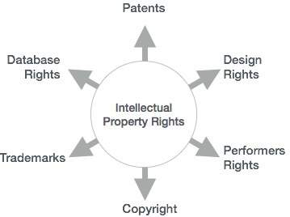
Intellectual Property Right

Slide 45
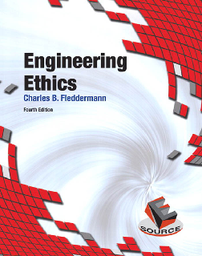
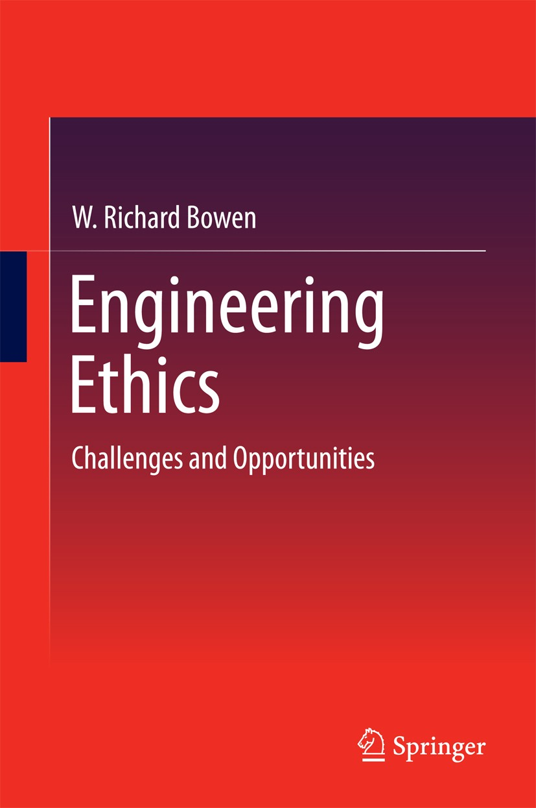

Recommended Readings

Slide 46
Thank You
Q & A
☺

